Slide 1









E-Commerce Mobile Application Development
Presentation By:
Varunraj Rachakatla
Nikith Kumar Bandaru
Uday Singamala
Mahesh Gudla
Srikanth Boppudi
Sai Krishna Koduri

Slide 2




Project Outline
Project Title: E-commerce Mobile App Development
Focus: User convenience and engagement
Key Features: User Registration, Product Browsing, Shopping Cart Management, Order Tracking
Technologies: React Native, MongoDB
Objectives: Seamless Shopping Experience, Business Growth
Scope: iOS and Android App Development, Key Feature Implementation, UX/UI Optimization
Testing: Functional, Usability, Performance, Security
Deployment: App Store (iOS), Play Store(Android)
Maintenance: Bug Fixes, Feature Updates

Slide 3





Introduction
The project aims to develop a feature-rich and user-friendly mobile application for e-commerce, catering to the growing demand for convenient and accessible shopping experiences. The mobile app will provide users with a seamless platform to browse, select, and purchase products on the go.

Slide 4




Problem Statement
The emergence of monopolistic market structures in the e-commerce industry, driven by major players like Amazon and Alibaba, presents significant challenges for smaller merchants and consumers alike. These industry titans leverage their vast resources and cutting-edge technologies to dominate the market, resulting in limited competition, reduced variety of items, and restricted customer choice. Small and local sellers face obstacles in competing effectively due to the lack of technology infrastructure and financial resources, leading to market consolidation and diminished diversity. To address these challenges, innovative solutions are needed to support local merchants and foster competition. Introducing a subscription-based application platform on mobile devices could provide a viable solution, empowering small businesses to compete more effectively while offering consumers greater choice and diversity in the marketplace.

Slide 5



Proposed Solution
Develop a feature-rich mobile application with intuitive navigation.
Ensure compatibility with various mobile platforms (iOS and Android)
Implement a secure payment gateway for safe transactions.
Provide real-time notifications to keep users informed.
Optimize the user interface and experience for seamless shopping.

Slide 6


Functional Requirements
Authentication and Security
User Account Management
Vendor Management
Navigation and User Experience
Product Management and Search
Order Fulfillment and Payment
Security and Privacy Measures
Additional Features

Slide 7
Non-Functional Requirements
Performance
Security
Stability
Availability
Scalability
User Experience
(UX)
Compatibility
Usability
Network Resilience
Compliance
Sustainability
Backup and Restoration

Slide 8


Architecture Plan
Design Patterns
MVC (Model-View-Controller):
Clear separation of concerns: Models handle data logic, Views handle presentation logic, and Controllers manage user input and application flow.
Facilitates code organization and maintainability.
Enables parallel development.
Strategy Pattern for Third-Party Integrations:
Encapsulates algorithms and makes them interchangeable.
Enhances flexibility and extensibility.
Promotes testability.

Slide 9
Platforms and Technologies
Backend: Node.js
Event-driven architecture.
Vast ecosystem of libraries and frameworks.
JavaScript-based for full-stack development.
Frontend: React Native
Cross-platform development.
Native performance.
Large community and ecosystem.
Database: MongoDB
Document-based NoSQL database.
Scalable and flexible for handling large datasets.
Easily integrates with Node.js for seamless backend development.

Slide 10
Third-Party Libraries
Stripe:
Secure payment processing.
Flexible billing solutions.
Seamless integration.
Algolia:
Lightning-fast search functionality.
Customizable and scalable.
Developer-friendly APIs.
Google Maps:
Robust mapping and location-based services.
Interactive maps with various customization options.
Seamless integration for displaying and interacting with maps in the application.

Slide 11
Hosting Strategy
Backend Hosting: Render
Fully managed platform.
Serverless architecture.
High availability and reliability.
Frontend Hosting: Play Store and App Store
Centralized distribution platforms.
Built-in monetization options.
Automatic updates.

Slide 12

Data Management Plan
The Data Management Plan for Storegrab's e-commerce app outlines a strategy to maintain data integrity, security, and accessibility. It covers key data entities like Users, Inventory, Orders, etc., detailing their fields and types. Access control and security protocols are outlined, including encryption. Functional requirements for storage and retrieval, along with features like search and recommendations, are discussed. Adherence to these guidelines is emphasized to protect data integrity and improve user experience.

Slide 13

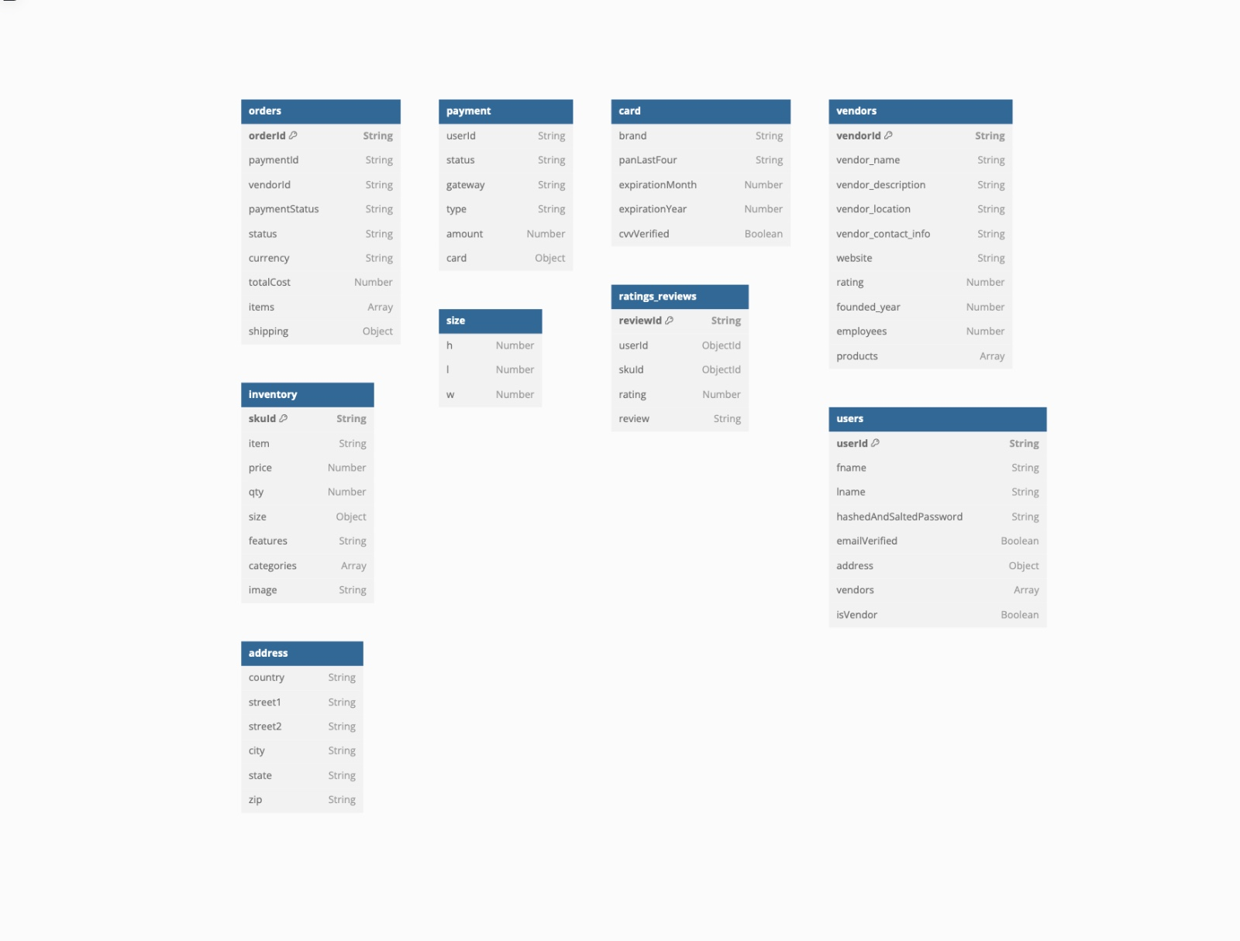



Database Schema Demo

Slide 14
Prototype demos
Home Screen:
Animated demonstration of the home screen prototype.
Brief description: The home screen features an intuitive layout with essential navigation elements and visually appealing design. It serves as the entry point for users to explore the application's features and content.
Authentication Page:
Animated demonstration of the authentication page prototype.
Brief description: The authentication page showcases the user login and registration process with a sleek and user-friendly interface. Users can securely authenticate themselves or create a new account, ensuring a smooth onboarding experience.
Animations for the prototypes can be found in the following slides.

Slide 15
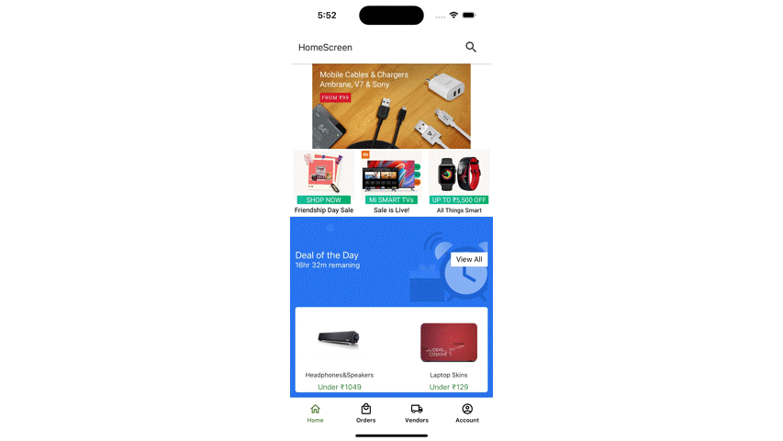
Home Screen

Slide 16
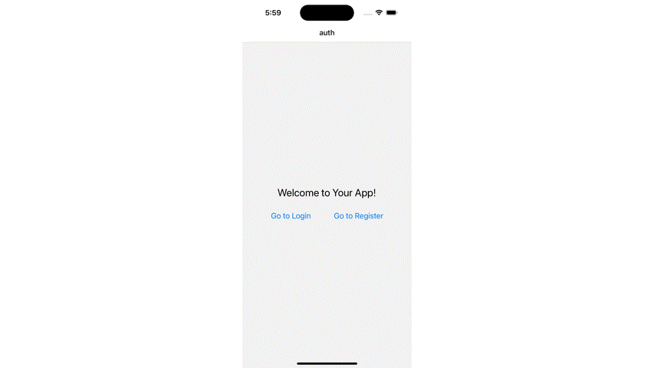
Authentication Page
Login
Register

Slide 17
Conclusion
Accomplishments
Developed a feature-rich e-commerce mobile application to address outlined challenges.
Implemented functional and non-functional requirements for seamless user experience.
Established robust data management plan for security, integrity, and availability.
Designed intuitive home page and navigation screens for enhanced user engagement.
Lessons Learned
Importance of efficient resource management within budget and timeline constraints.
Compliance with regulations and app store guidelines for successful deployment.
Need for continuous improvement and adaptation based on user feedback.
Collaboration and communication among team members for successful project execution.

Slide 18
Summer 2K24 Plan
Finalize GUI Designs
Implement Core Features
Conduct User Testing
Iterate and Refine
Integration of Third-Party Services
Backend Development (Node.js, MongoDB)
Frontend Development (React Native)
Testing and Quality Assurance
Deployment and Release
Documentation and Training

Slide 19
Reference
Node.js: Node.js Documentation
React Native: React Native Documentation
MongoDB: MongoDB Documentation
Stripe: Stripe Payment Gateway Documentation
Algolia: Algolia Documentation
Google Maps Services: Google Maps Services Documentation
Render: Render Documentation

Slide 20


Thank YOU

